Slide 1

Web APIs & Classification
Reddit
Notes:
Hi, today I am going to present on Reddit’s API and classification. We will be looking at 2 subreddits - Singapore and Japan

Slide 2
Problem Statement
Previously, Reddit had a subreddit called r/SingaporeAndJapan that welcomed discussion on both Singapore and Japan topics.
Subreddit was decided to be split in r/Singapore and r/Japan.
Engaged our services to archive the old posts into the appropriate new subreddits.
Aim is to create a model that can accurately classify post from old subreddit.
Notes:
Previously, Reddit had a subreddit called Singapore and Japan. It consists of discussion from both Singapore and Japan.
Due to disagreements between the moderators, they decided to split them individually in Singapore and Japan subreddit.
The respective moderators are still keen to migrate the old posts from the combined subreddit into the new individual subreddits for archiving purposes.
They have asked us to archive the old posts into the appropriate new subreddits.

Slide 3
Methodology
Data Collection
Data Cleaning
Preprocessing
Hot
Controversial
New
Top
Total: 1804 distinct posts
54% Singapore
46% Japan
Using requests library
Removal of html tags, non-alpha letters, white spaces, non-english characters
Tokenizing, lemmatizing with pos tags, removal of stopwords
Notes:
Firstly, using the requests library for python, the subreddit’s API were scrapped. We started out scrapping using the base url and generating the set of posts but many duplicated posts were returned. Hence, we then tried including words like hot, controversial, new and top to be more specific and gather more unique posts. We aim to scrap 1000 posts from each subreddit. We ended out with a total of 1804 distinct posts, 54% were from Singapore while 46% were from Japan.
After collecting the data, we cleaned it by removing the html tags, symbols like question marks, apostrophe, colons etc, numbers, white spaces were also removed. To understand the characters, we also removed japanese characters that could have been important in the Japan subreddit.
Thereafter, we tokenize the words - separating the sentences into individual words, and lemmatize them - reducing the words into their base form (noun, adj, adverb and verb tagging)

Slide 4
Methodology
4. Modeling
5. Evaluation & Conclusions
Count Vectorizer
TF-IDF Vectorizer
Logistic Regression
Multinomial Naive Bayes
Support Vector Classifier
Random Forest
Accuracy scores
Multinomial Naive Bayes
Further improvements can be done
Notes:
We tried out 4 models in total. They will be paired up with either the CV or TV to see which are the best pair. The first model i tried was Log Reg because it is the most commonly used and basic model together with Count Vectorizer which was counting the number of words that appeared in each posts (more basic than Tvec), from there I did EDA to find out common words appearing in each subreddits and misclassified words to be feature selected as stopwords. Accuracy score was selected to be the determining metric because our objective is to correctly predict the post from the old subreddit.
Thereafter, we move on the MNB which is based on Bayes Theorem, SVC to find the best hyperplane that separate the two classes and random forest which uses resampling to generate numerous decision trees with a subset of feature selection.
MNB showed to be the best model that can accurately predict the posts into the individual subreddits. However further improvements can be done to improve the accuracy.

Slide 5
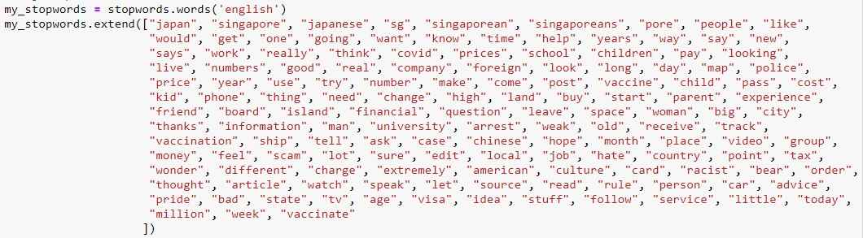
Stopwords
Misclassified words with more than 5 frequency
Logistic Regression with Count Vectorizer
Common words appearing in both subreddits
Notes:
These are the stopwords which include synonyms of the subreddit name, misclassified words > 5 times and common words appearing in both subreddits from the first basic model of count vec and logistic regression. Covid, vaccinate appear here as well due to the current pandemic and its a global topic that appear in both subreddits.

Slide 6
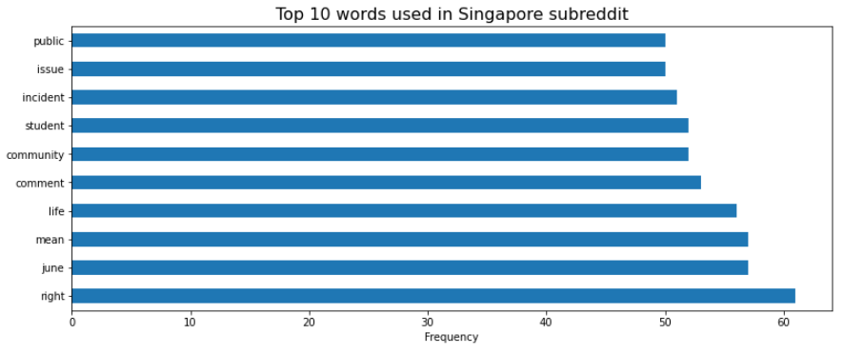
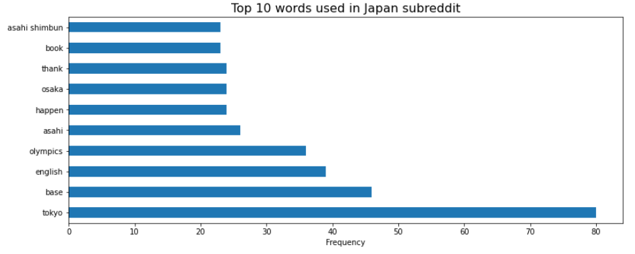
No common words
Notes:
The process continued until we are left with no common words left in the top 10 words of each subreddits. We can see that there may be words that do not really identify with each subreddit like right or thank. However, they might be due to cultural difference and more common use of language in each country.

Slide 7
Logistic Regression
Top Predictive Features
With Countvectorizer stopwords
Singapore
Japan
community
june
wait
jail
mrt
tokyo
osaka
olympics
taiwan
june
community
wait
mrt
grc
tokyo
olympics
osaka
asahi
With TF-IDF vectorizer stopwords
Singapore
Japan
Notes:
Logistic regression is a linear classification method that learns the probability of a sample belonging to a certain class. Logistic regression tries to find the optimal decision boundary that best separates the classes. Discriminative model, learn input to output mapping by minimizing errors.
Discriminative -> “distinguishing between people that speak different languages without actually learning the language”.
For log reg, they prefer to include the count vectorizer stopwords as a hyperparameters. Hence, the predictive words ended up to me less generic and more specific to each subreddits.
Both vectorizer words are similar to each other.

Slide 8
Multinomial Naive Bayes
Top Predictive Features
Without Countvectorizer stopwords
Singapore
Japan
go
even
also
see
many
take
give
find
much
go
find
tokyo
see
anyone
also
base
could
much
june
go
community
see
take
give
back
tokyo
find
olympics
go
anyone
asahi
osaka
Without TF-IDF vectorizer stopwords
Singapore
Japan
Notes:
Naïve Bayes is a classification method based on Bayes’ theorem that derives the probability of the given feature vector being associated with a label. Naïve Bayes has a naive assumption of conditional independence for every feature, which means that the algorithm expects the features to be independent which not always is the case.
Generative model, more assumptions, model joint distribution between x and y
Without using the stopwords, tfidf help to reduce the importance of common words appearing in all posts. It picks up interesting words that are frequent in 1 document compared to the rest of the documents.

Slide 9
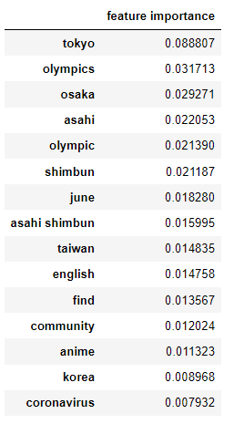
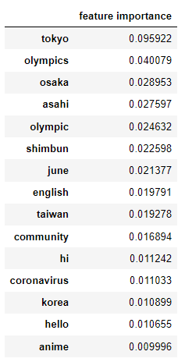
Random Forest
Feature importance
Count vectorizer
TF-IDF vectorizer
Notes:
Features more closely related with dependent variable and contribute more for variation of dependent variable. Relative importance of features. Higher the number = more important in classification task

Slide 10
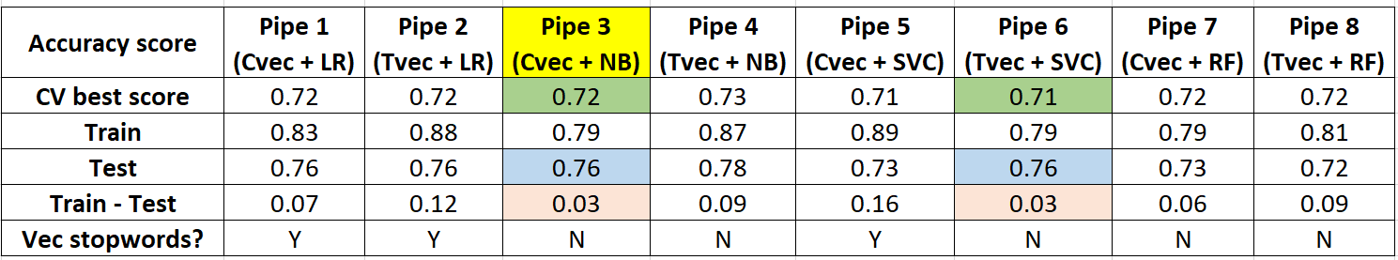
Modeling
Notes:
Least overfitted models: Pipe 3 & Pipe 6 (same train and test scores. CV best score: Pipe 3
Even though the predictive features seems to be more generic, it still gives the highest accuracy to predict where a post is from. As our objective is to archive the post accurately, we the predictive features are not our main focus here.

Slide 11
Evaluation & Conclusions
Accurately predict the post:
Use Count Vectorizer with Multinomial Naive Bayes.
Further improvements:
Exploring other columns, apart from selftext and title from the reddit API.
Analyse misclassification and common words from other models.
Exploration on more complex POS tagging in lemmatization.
Notes:
To separate the posts from the old combined singapore and japan subreddit into the new individual singapore and japan subreddits, we want to accurately predict the subreddit a given post came from. Hence, our goal is to find the best model that can give the best accuracy. We would use CV with MNB model. More indepth analysis could be done to improve the accuracy of the models.
Explore non text columns to gain more insights and predictive capabilities.
Find where the misclassification words are from the other models.
Reduce the occurrence of similar words that can be reduced to 1 word to represent them so as to be more predictive towards the target class.

